Slide 1
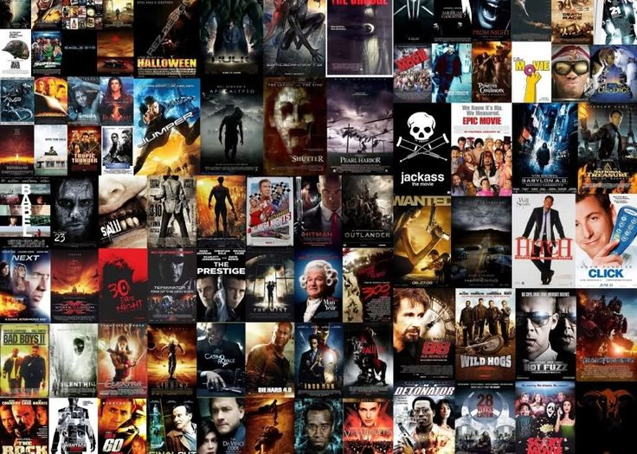
IMDB Movie Analysis

Slide 2

Description
For the project, a dataset of different IMDB movies is provided, containing various columns and rows.
Clean and analyze data to derive insights.
It is required to frame the problem
Our task requires defining a problem and providing an analysis of it.

Slide 3

APPROACH
The dataset was cleaned by removing unnecessary columns and null values.
Five “Why” approach.
Analyzed the data using pivot tables to derive useful business insights and fetch required results.
After the analysis is complete, visualization is used to communicate the findings.

Slide 4



TECH-STACK Used
Software used while making the project :
MS Office Excel
Microsoft PowerPoint

Slide 5

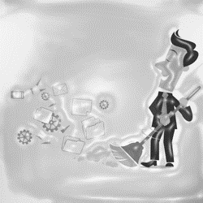
DATA CLEANING
This is one of the most important steps to take before moving forward with the analysis.
Task: Clean the Data
To ensure that I did not damage the original data, I first created a copy of the raw data before conducting any analysis. Later, I removed columns that were not required for the analysis.
After deleting the columns, I removed the rows which have null values in any of the column values.
Finally, using the “Remove duplicate values/cells” option found in the “Data” tab, remove the duplicate values in the data.

Slide 6

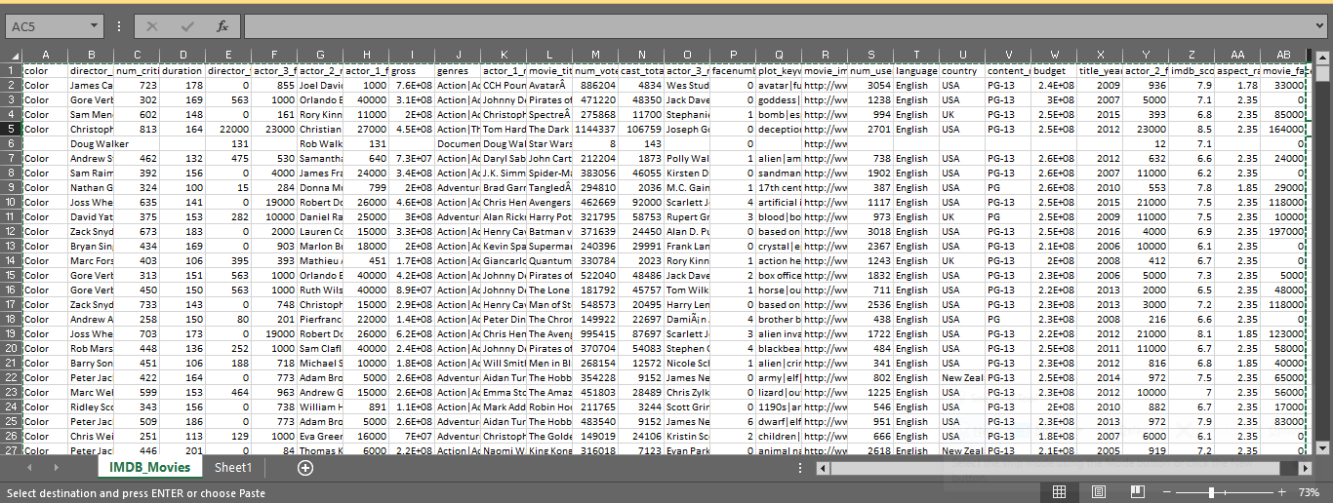
DATA CLEANING
Old Data

Slide 7

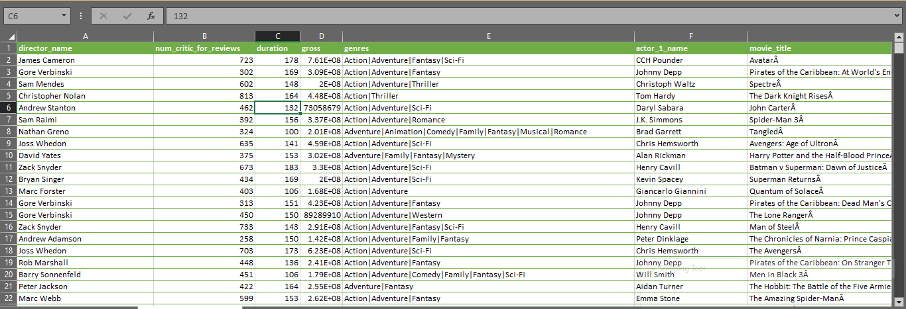
DATA CLEANING
New Data

Slide 8

Movie Genre Analysis

Slide 9

TASK: Determine the most common genres of movies in the dataset. Then for each genre calculate descriptive statistics (mean, median, mode, max, min, variance, standard deviation) of IMDB score. Created a pivot table with genres and average imdb_score. Created a table with the two mentioned columns. Sorted the table from largest to smallest with respect to the average imdb_score. Determined the Median, mode, max, min, variance, and standard deviation using Excel functions.

Slide 10
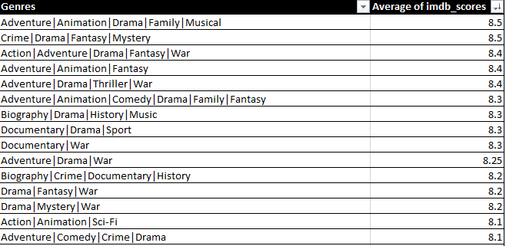

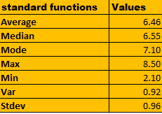
action|animation|drama|family|musical have the highest average IMDb score of 8.5 and action|sports have the least and have a score of 2.1. thus it is concluded that action is the most favoured genre.

Slide 11

MOVIE DURATION ANALYSIS

Slide 12

Task: Analyze the distribution of movie durations and its impact on the IMDb score.
Created a pivot table with duration and imdb_score.
Created a table with these two mentioned columns.
Sorted the table from largest to smallest with respect to the imdb_score.
Determined the Average, Median, Standard deviation, etc using Excel functions
Created a scatter plot between duration and imdb_score and generated a trend line.

Slide 13
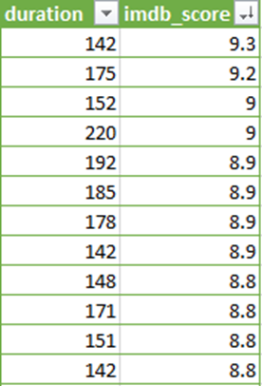


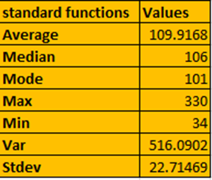
The average duration of movies is 110 mins and the Median is 106 min. While the standard deviation of the duration is 23.

Slide 14

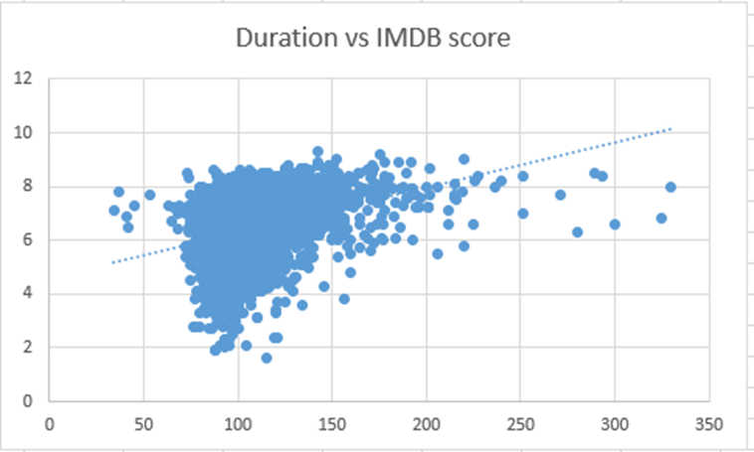

From the chart its clear that the majority of the films are in the range of 2-6 IMDB scores. Though the trend line shows an upward line.

Slide 15

LANGUAGE ANALYSIS

Slide 16
Task: Determine the most common language used in movies and analyze their impact on the IMDB score using descriptive statistics.
Created a pivot table with language and count of imdb_score.
Created a table with these two mentioned columns.
Sorted the table from largest to smallest with respect to the count of imdb_score.
Determined the Average, Median, and Standard deviation using Excel functions.

Slide 17
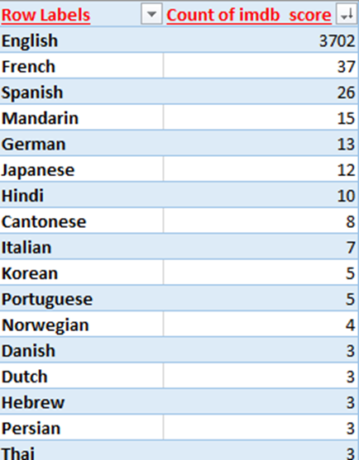
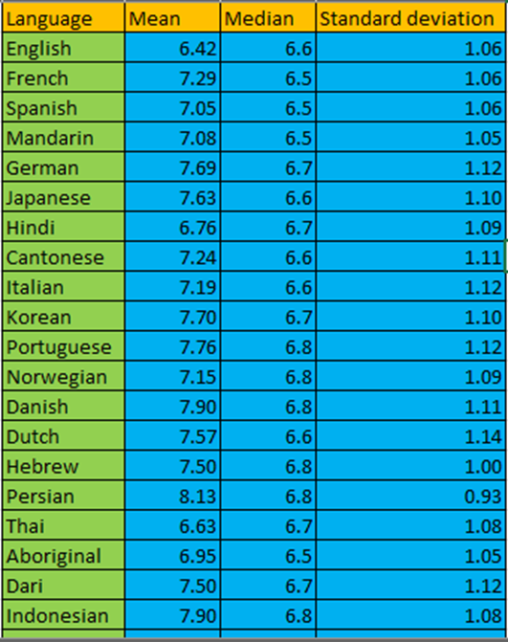

The most popular /common language is English.
Even though English is the most common language it does not have the highest mean.
None has the highest mean of 8.5 while Bosnian has the lowest mean of 4.3 and English has a mean of 6.42.
Many of the languages have the same median and mean
Again None has the highest median of 8.5 whereas Bosnian has the lowest median of 4.3 and English has a median of 6.6.
Dutch language has the highest standard deviation of 1.14 while English has a standard deviation of 1.06.

Slide 18

DIRECTOR ANALYSIS

Slide 19
Task: Identify the top director based on their average IMDB score and analyze their contribution to the success of movies using percentile calculation.
Created a pivot table with director_name and average of imdb_score.
Created a table with these two mentioned columns.
Created two new columns named PERCENTRANK and PERCENTILE.
Calculated PERCENTRANK and PERCENTILE using Excel functions.
Sorted the table from largest to smallest with respect to the average of imdb_score.

Slide 20

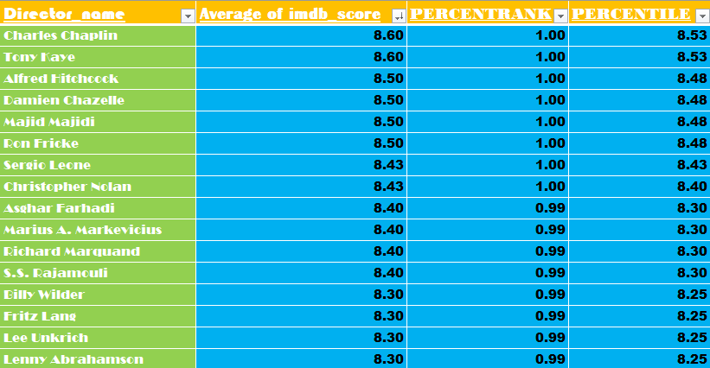
Charles Chaplin’s movies has the highest average IMDb score of 8.6 and a percentile of 8.53
On the other hand, Vondie Curtis-Hall’s movies have the lowest average IMDb score of 2.1 and a percentile of 2.1.have

Slide 21

BUDGET ANALYSIS

Slide 22
Task: Analyze the correlation between movie budgets and gross earnings, and identify the movies with the highest profit margin.
Created a table with gross and budget.
Created a new column called Profit.
Calculated the profit for all the data points (Profit = gross-budget).
Calculated the correlation using the CORREL function and Maximum profit using the MAX function.

Slide 23
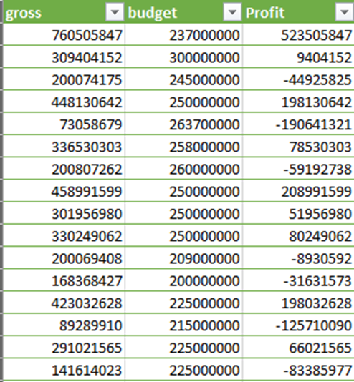
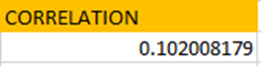
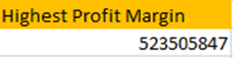
The Highest Profit Margin is of “Avatar” with a number of 52,35,05,847.

Slide 24

Insights and Results
During the IMDB Movie Analysis project, I improved my logical, statistical, and technical skills to extract important insights from the dataset. I became proficient in using statistics and Microsoft Excel's features to analyze data and selecting appropriate visualization graphs.

Slide 25
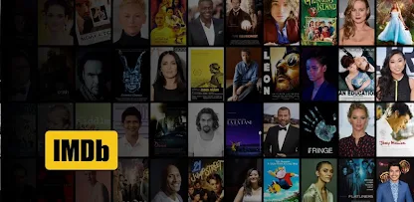
By- ALANKRITA PAUL
THANK YOU
https://docs.google.com/spreadsheets/d/1DfjtSyQZzDfvTRggdueRjhUux-0_i2A5/edit?usp=sharing&ouid=102920283787458652340&rtpof=true&sd=true

